Slide 1
Intro to Relational Databases & SQL

Slide 2
AGENDA
Introduction to Relational Databases
Data Modeling
Relational Data Model
Relational Databases
SQL
Querying using SQL

Slide 3
1. Introduction to Relational Databases

Slide 4
Databases
Why do we need databases?
Main types of database
Key-value storage (Redis, Memcache)
Document (MongoDB, CouchDB, Cassandra)
Relational/SQL (SQLite, PostgreSQL, MySQL, Oracle, SQLServer)
Why are relational databases still popular?
It's about structure, consistency & flexibility

Slide 5
2. Data Modeling

Slide 6
Entity Relationship Model
Fundamental step that provides a view of business data after identifying & analyzing relevant entities
Expressed in terms of entities in the business environment, the relationships among those entities, and the attributes of both entities and relationships
Represented as Entity Relationship Models (ERD) or Logical Models

Slide 7
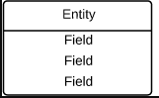
ERD
Entities
Cardinalities
Relationships

Slide 8
3. Relational Data Model

Slide 9
Models Comparison
Feature | Entity | Logical | Physical
Entity Names | ✓ | ✓
Entity Relationships | ✓ | ✓
Attributes | Optional | ✓
Primary Keys |  | ✓ | ✓
Foreign Keys |  | ✓ | ✓
Table Names |  |  | ✓
Column Names |  |  | ✓
Column Data Types |  |  | ✓

Slide 10
Primary & Foreign Keys
Primary keys (PK)
Unique identifiers of the entity/relation that guarantee that all rows in the table are unique
Examples: employee numbers, social security numbers
Foreign keys (FK)
Identifiers that enable a dependent relation (on the many side of a relationship) to refer to its parent relation (on the one side of the relationship)

Slide 11
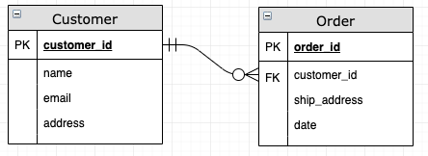
Primary & Foreign Keys

Slide 12
Relational Data Model : ERD / Logical
Problem
Implementing a quiz that contains questions and user's submissions to each question.
A quiz can have many multi-choice questions & users can skip answering certain questions
Requirements
Quiz has many questions
Questions have many options (multi choice)
Questions have many answers or none
A submission has a user key
A submission has many answers

Slide 13
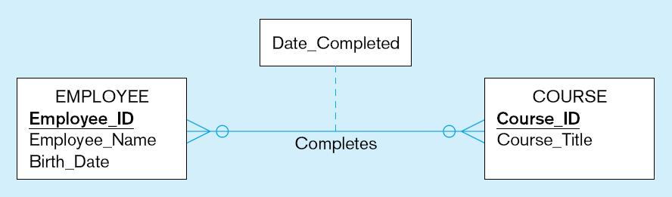
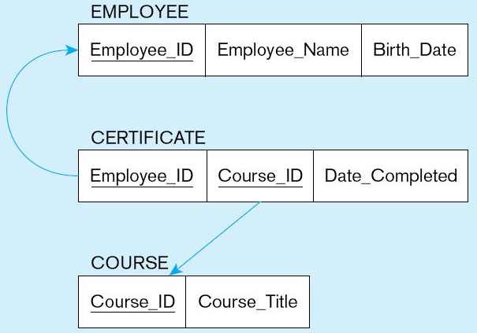
Transforming Many to Many Relationships
Composite primary key
A new entity/relation is created for connecting Employee & Course
A composite PK (or unique id)
A FK to Employee
A FK to Course

Slide 14
Where did FKs go?

Slide 15
4. Relational Databases

Slide 16
Relational Databases
Web App
RDBMS
SQL Client

Slide 17
Terminology
RDBMS (Relational Database Management System)
Database management system that manages data as a collection of tables in which all relationships are represented by common values in related tables
Relational Database (DB)
Collection of data items organized as a set of formally-described tables from which data can be accessed or reassembled in many different ways without having to reorganize the database tables
Table (Relation)
Data container for one or more data categories organized in rows (individual instances also called records) and columns (single attributes for each row)

Slide 18
5. SQL (Structured Query Language)

Slide 19
SQL : SELECT Statement (AKA Query)
Used for queries on single or multiple tables
Clauses of the SELECT statement:
SELECT (List of columns to return)
FROM (List of tables where columns are)
WHERE (List of conditions that values should meet)
GROUP BY (List of columns to group by – folding results)
HAVING (List of conditions that grouping should meet)
ORDER BY (List of columns to sort results by)

Slide 20
SQL : SELECT Statement (AKA Query)
SELECT
artists.name, count(artists.id)
FROM artists
JOIN albums ON albums.artist_id = artists.id
WHERE albums.year > 2000
GROUP BY artists.id
HAVING count(artists.id) > 1;

Slide 21
SQL : INSERT Statement
Adds data to a table
INSERT INTO customer VALUES (1, `Frank Casola`, `1355 S. Himes Blvd.`, `Gainesville`, `FL`, 32601);

Slide 22
SQL : UPDATE Statement
Modifies data in existing rows, criteria is determined by WHERE clause
UPDATE product SET unit_price = 775
WHERE product_id = 7;

Slide 23
SQL : DELETE Statement
Removes rows from a table based on certain criteria using the WHERE clause
DELETE FROM customer WHERE state = `HI`;
*Caution: This statement deletes all rows (entire table is wiped out)
DELETE FROM customer;

Slide 24
SQL Joins

Slide 25
6. Querying using SQL

Slide 26
ERD for a Music Database

Slide 27
Querying the Music Database
All tracks, with artist name and album name
All artists with tags
# of albums per artist
# of albums per artist who have more than 2 albums, published after 2000
Number of tracks in albums of each tag, in order
Outer join

